Slide 1

19ECE204 Digital Electronics and Systems III Semester B. Tech. (ECE & CSE) Amrita School of Engineering, Bengaluru
Synchronous Sequential Circuits

Slide 2
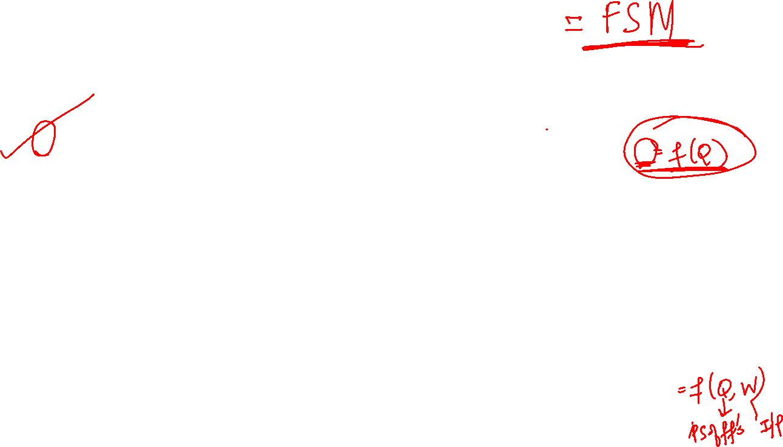


Slide 3

Sequential Circuits
We considered combinatorial logic circuits in which outputs are fully determined by the present values of the inputs.
We also considered simple storage elements that can be implemented in the form of flipflops for which the output depends on their states rather than the value of the inputs; the inputs cause changes in the state.
In this lecture we deal with a general class of circuits in which the output depend on the past behavior of the circuit, as well on the present values of the inputs.
They are called sequential circuits.

Slide 4

Synchronous vs Asynchronous
In most cases a clock signal is used to control the operation of a sequential circuit.Such circuit is called synchronous.
• The alternative, in which clock signal is not used, is called asynchronous sequential circuits.
• Synchronous circuits are easier to design and are used in the vast majority of practical applications.

Slide 5



Slide 6



Slide 9
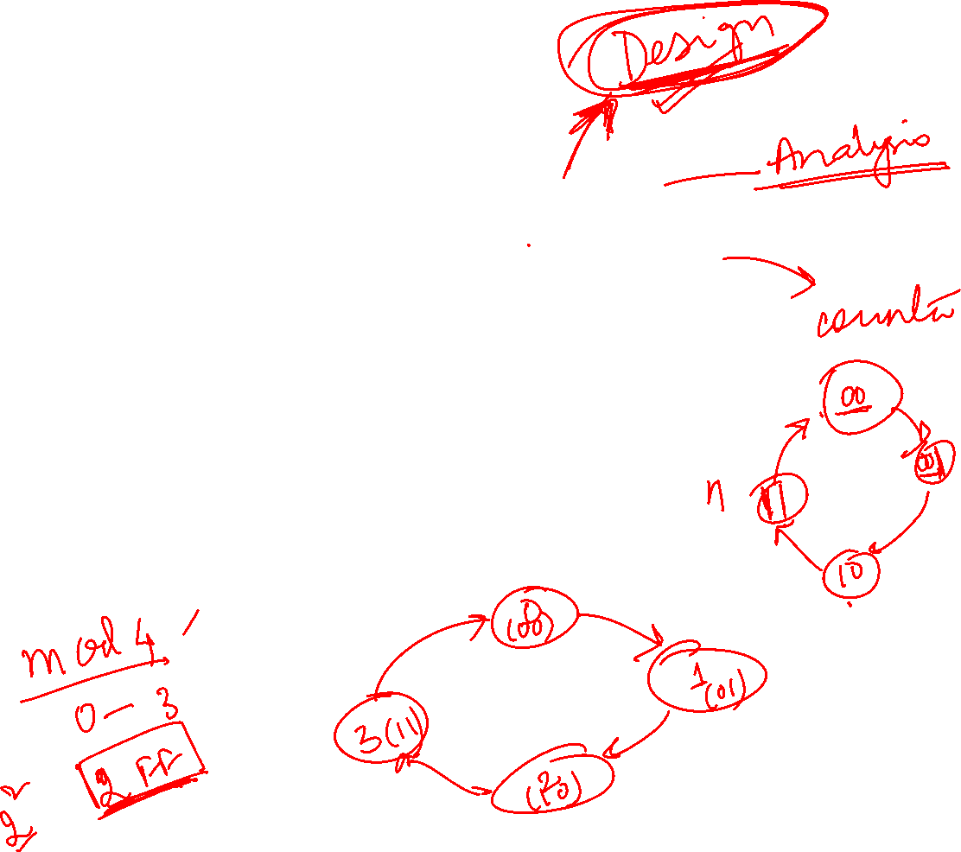

Slide 10
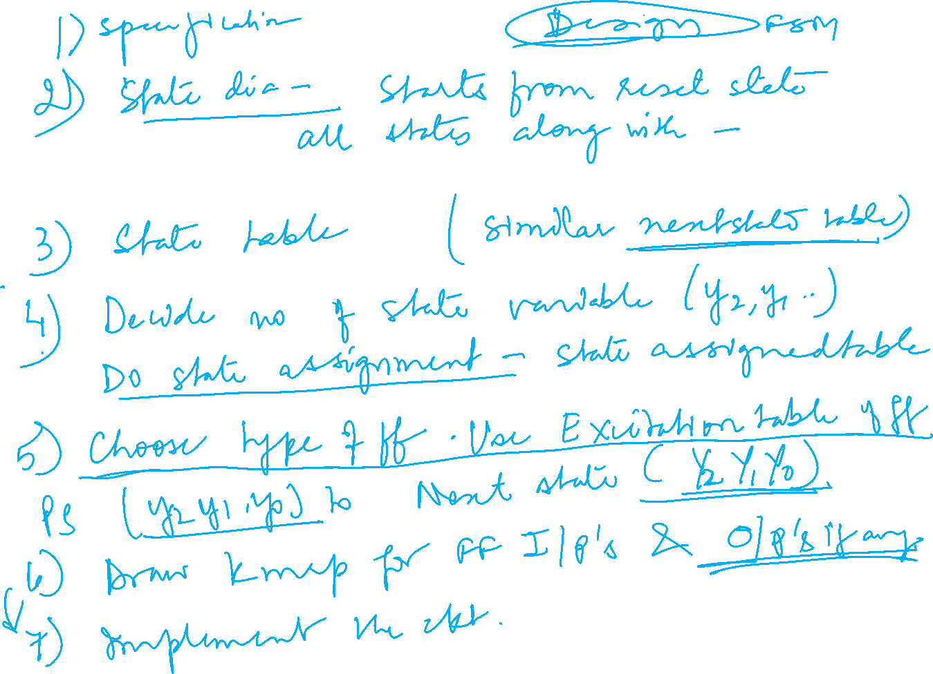

Slide 12


Slide 13
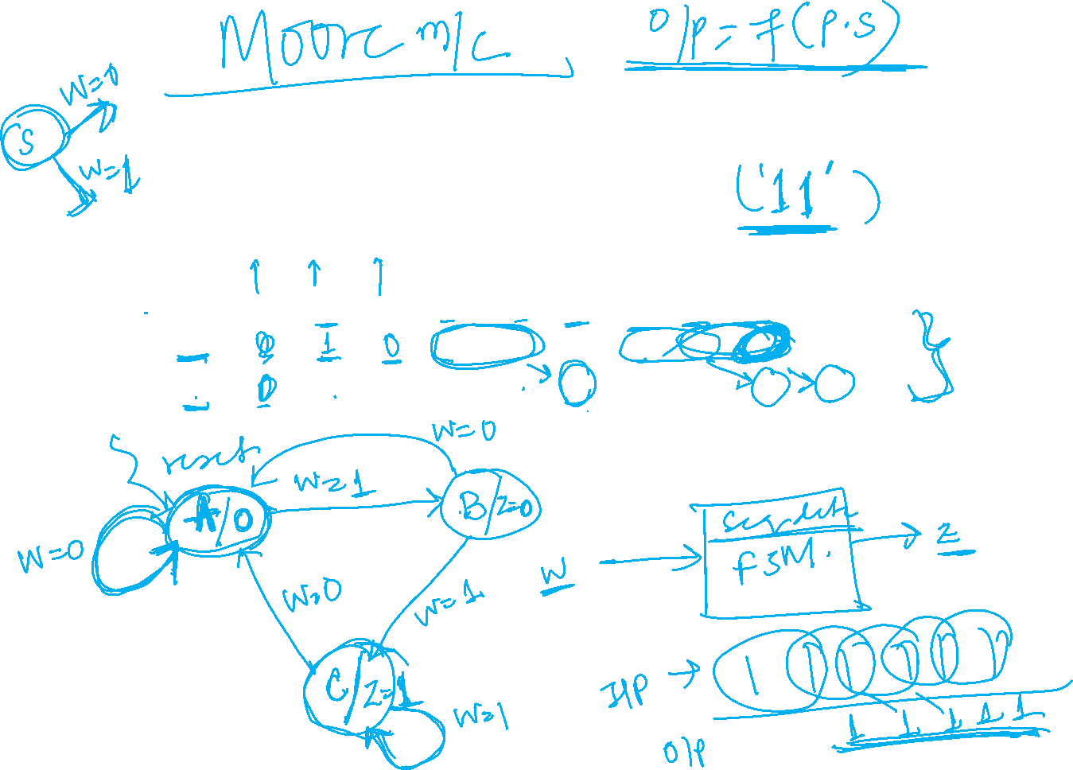

Slide 14
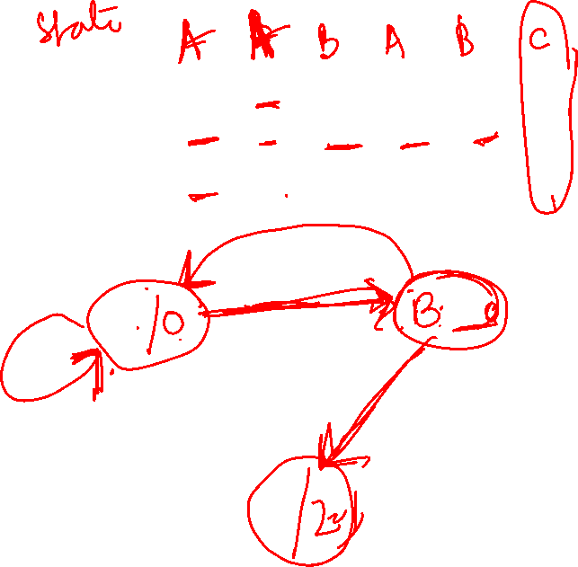


Slide 16
State Diagram

Slide 17
State Table

Slide 18
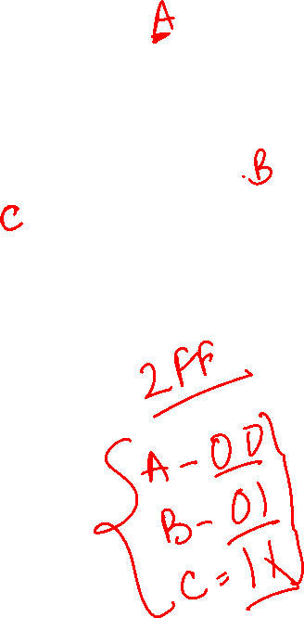
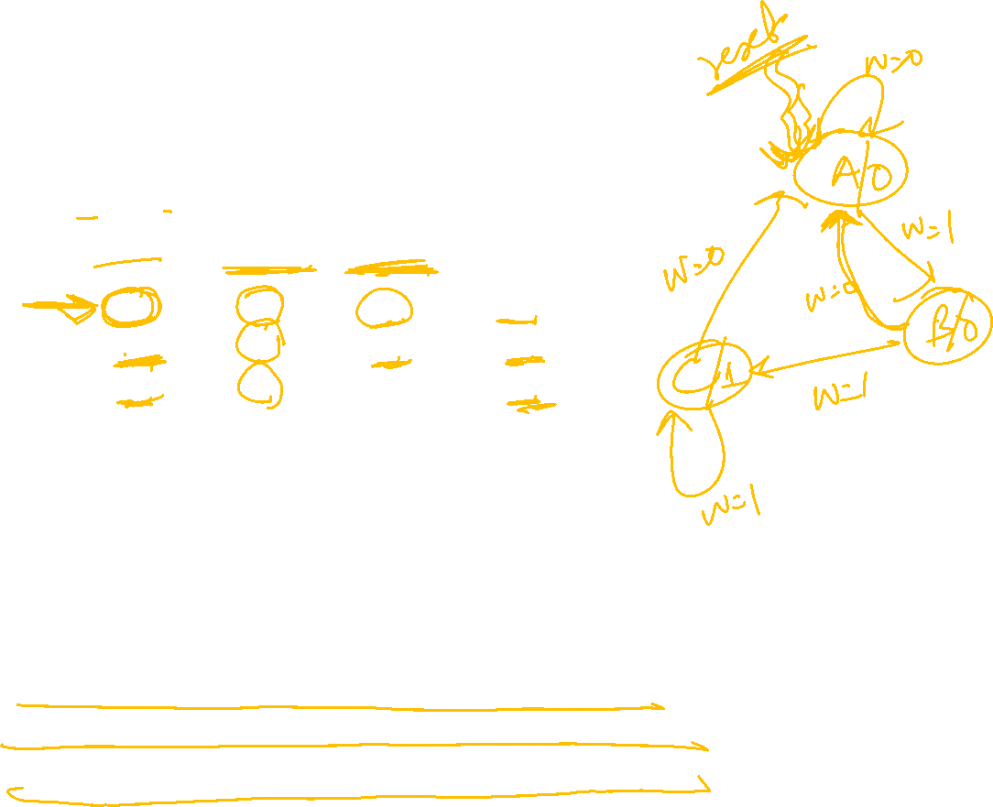
State Table

Slide 19
State Assignment(1)

Slide 22
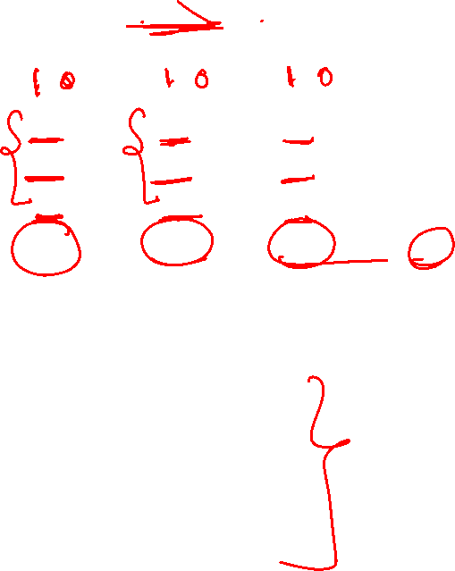

State Assignment(4)

Slide 23
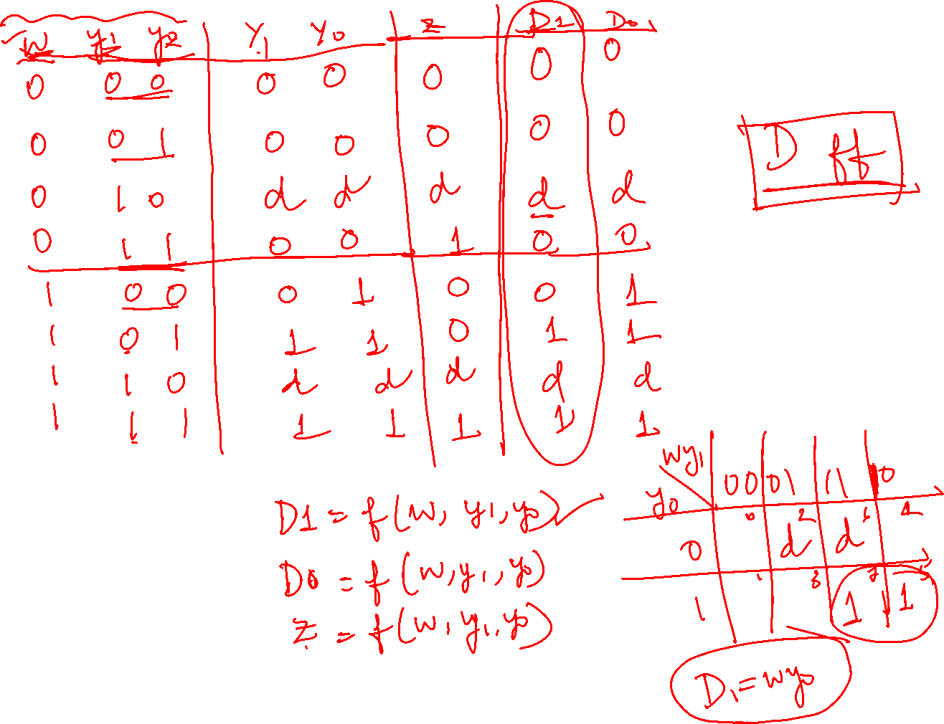



Slide 25
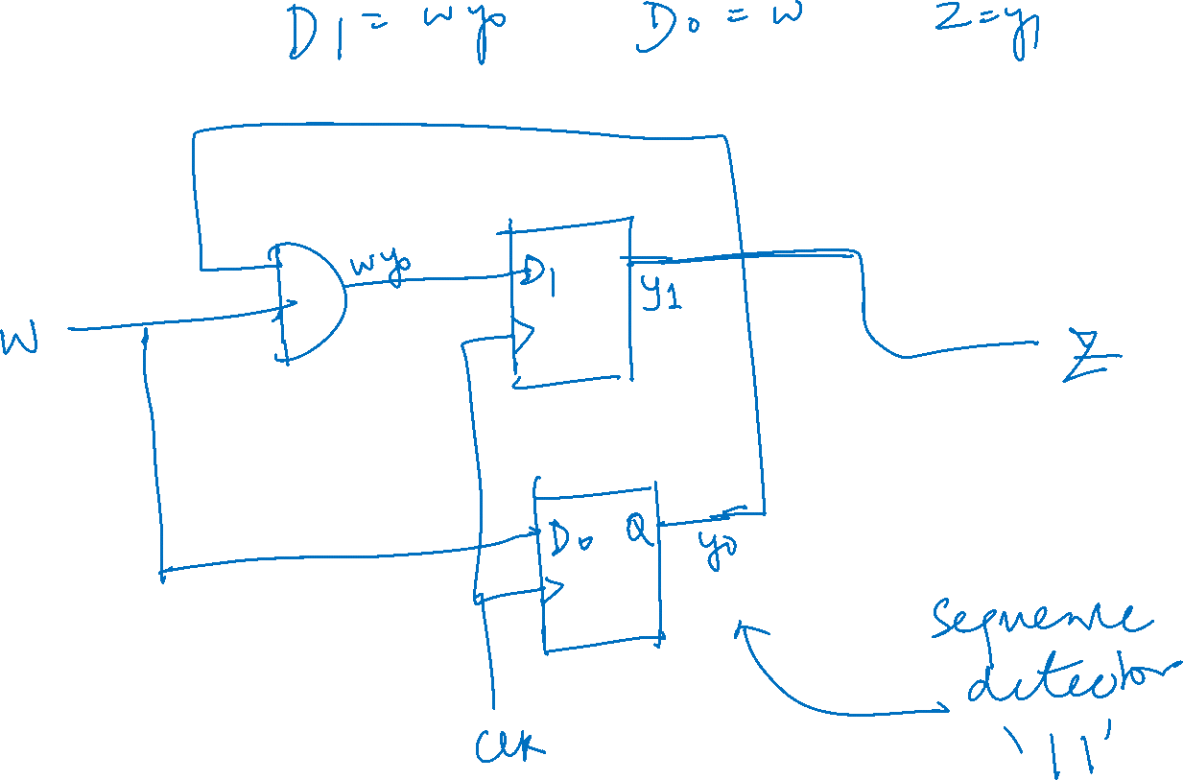

Slide 26


Slide 27
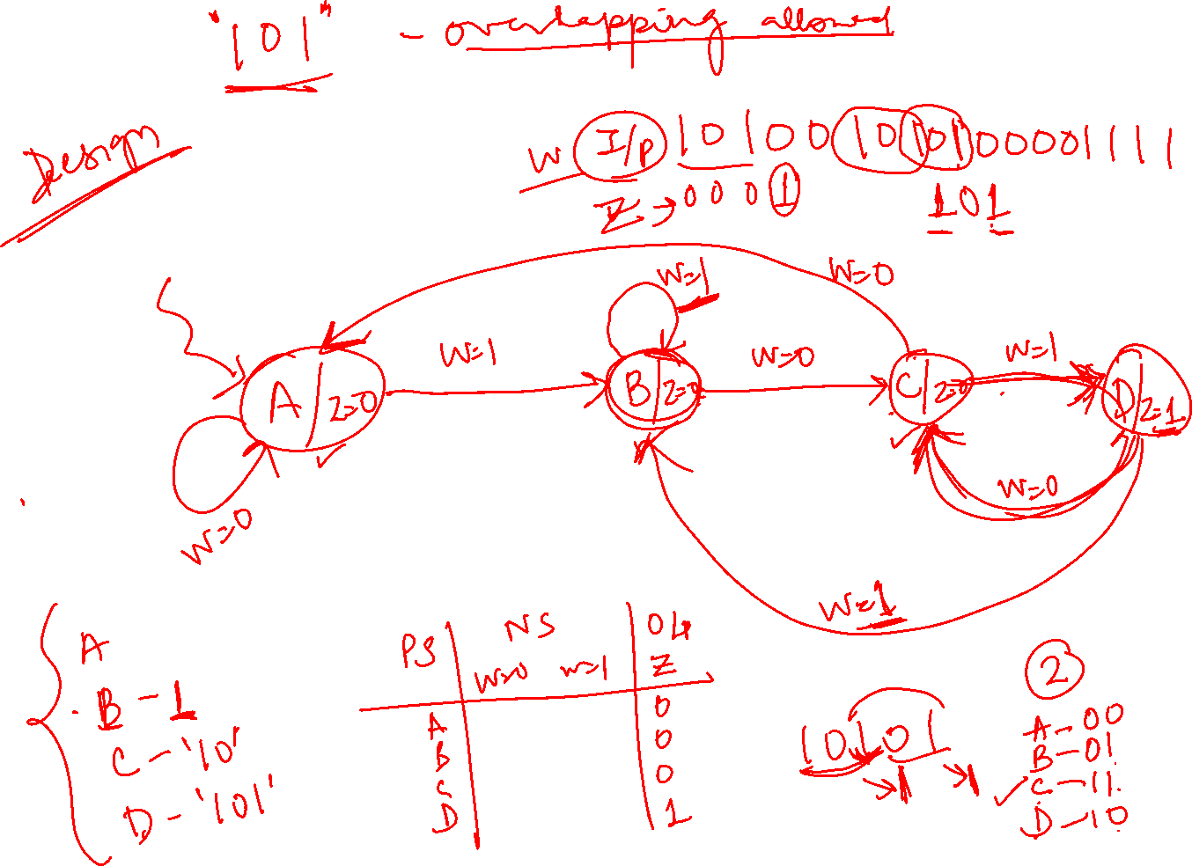

Slide 28
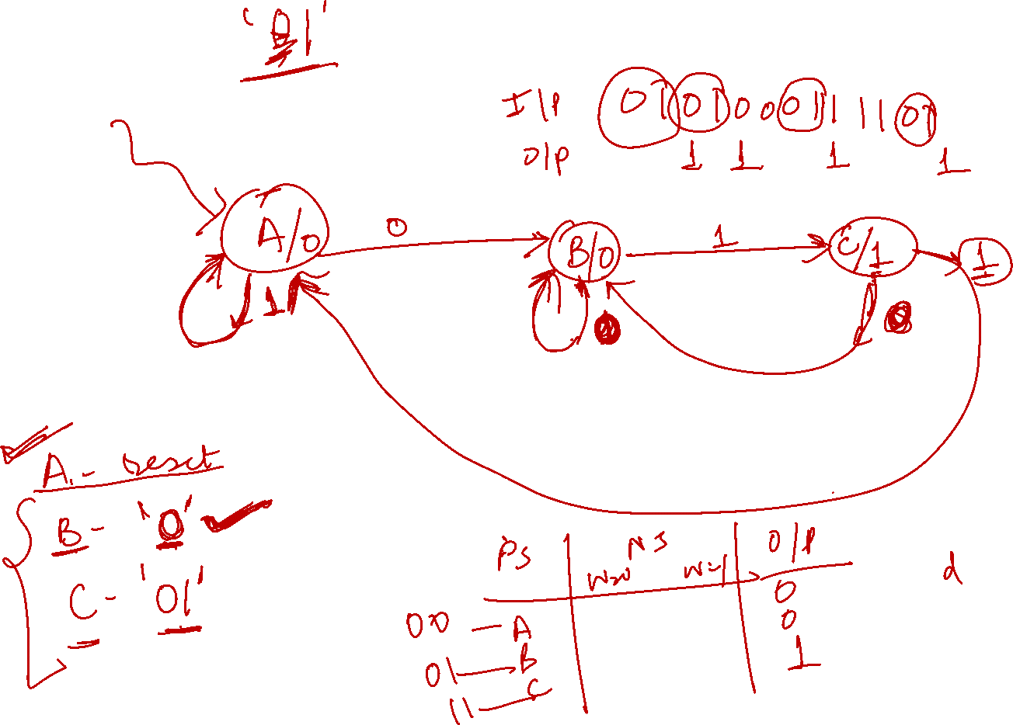

Slide 32


Slide 33
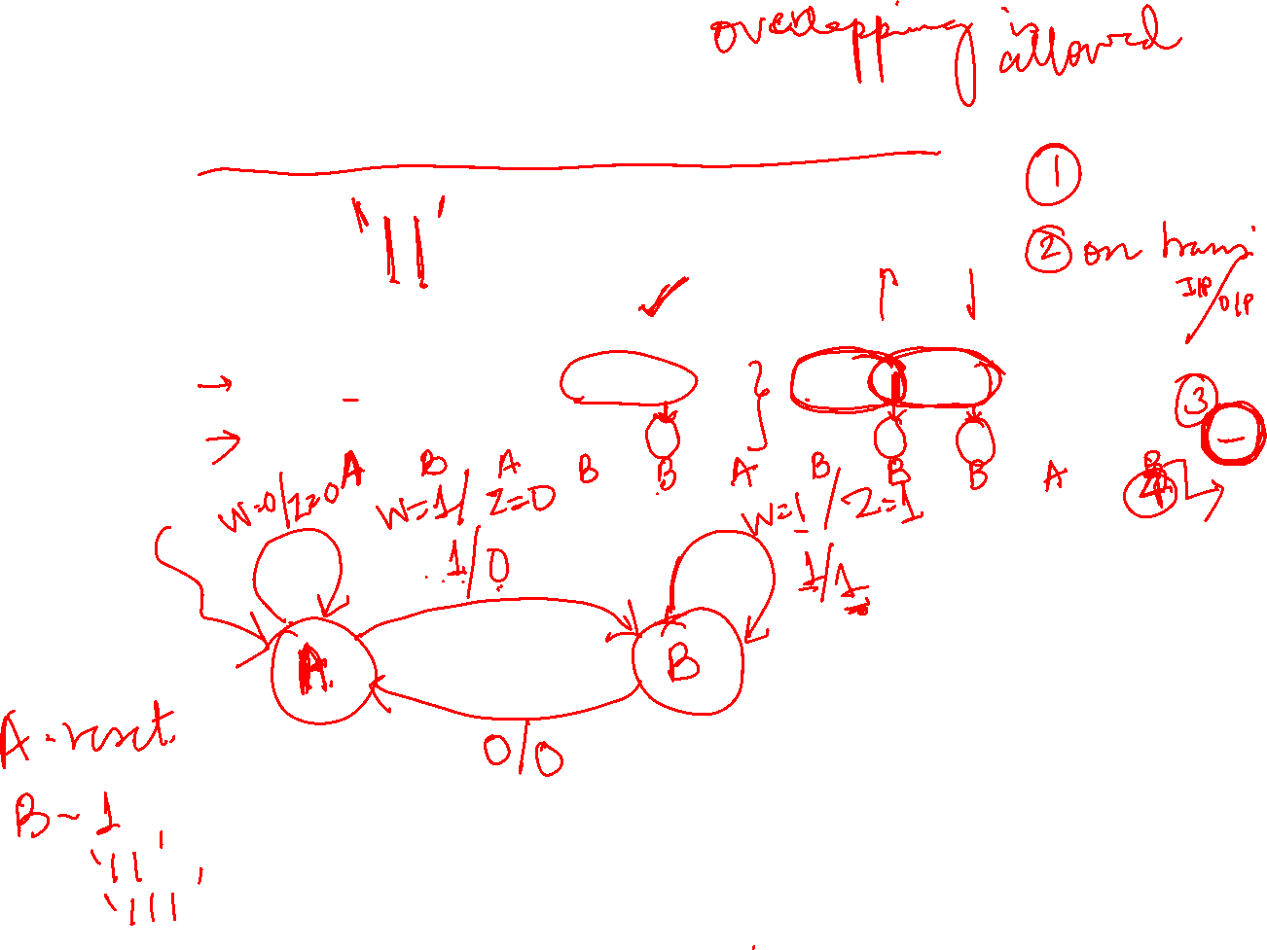
Mealy state model

Slide 34
Mealy state model
Sequence of input –output & State Diagram

Slide 35
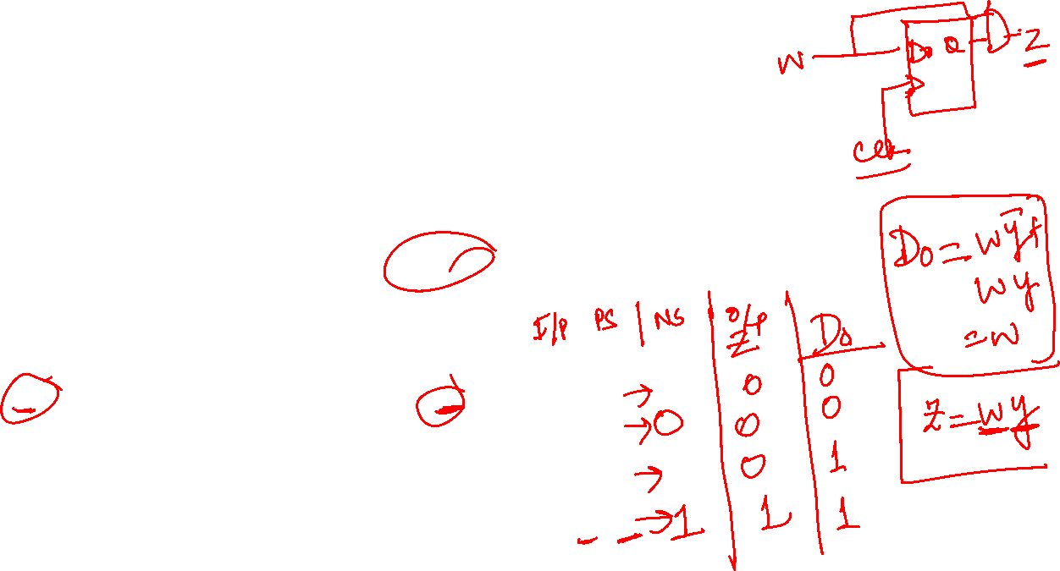
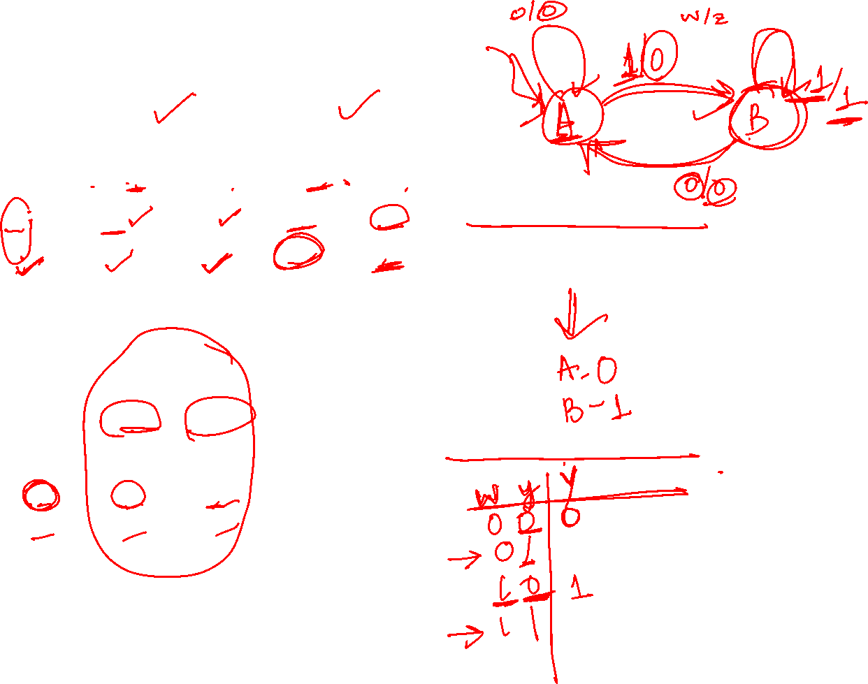
State TABLE for FSM
State ASSIGNED TABLE for FSM

Slide 36
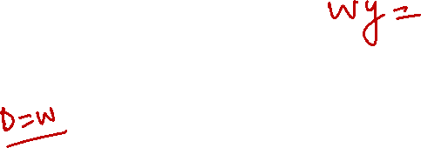
Circuit for Mealy FSM

Slide 37


Slide 38
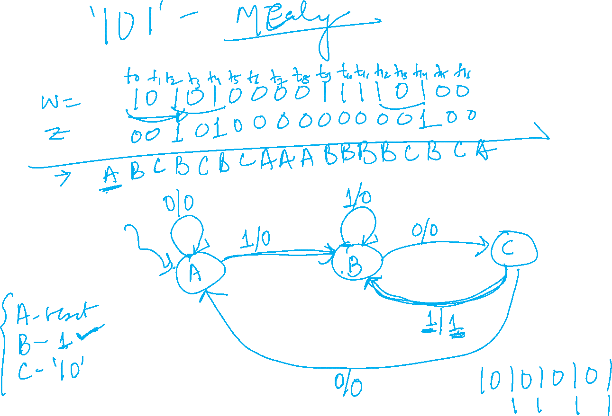

Slide 39


Slide 40
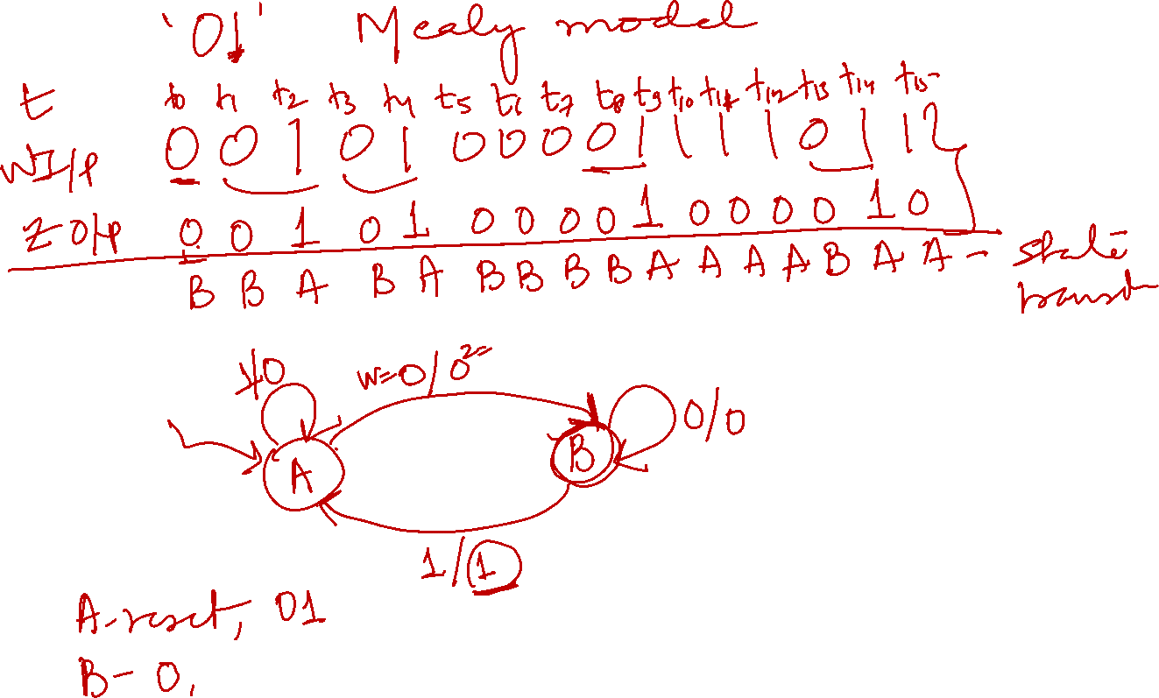

Slide 41
Sequential Circuit Design
Understand specifications
Draw state graph (to describe state machine behavior)
Construct state table (from state graph)
Perform state minimization (if necessary)
Encode states (aka. state assignment)
Create state-assigned table
Select type of Flip-Flop to use
Determine Flip-Flop input equations and FSM output equation(s)
Draw logic diagram

Slide 42
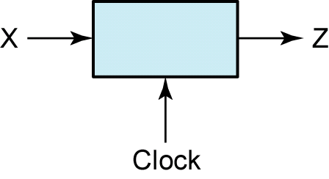
Example: A sequence detector (Mealy)
To illustrate the design of a clocked Mealy sequential circuit, we will design a sequence detector.
The circuit is of the form:
serial bit stream (input)
output (serial bit stream)

Slide 43
Example: A sequence detector (Mealy)
Suppose we want to design the sequence detector so that any input sequence ending in 101 will produce an output of Z = 1 coincident with the last 1.
The circuit does not reset when a 1 output occurs.
A typical input sequence and the corresponding output sequence are:
X = 0 0 1 1 0 1 1 0 0 1 0 1 0 1 0 0
Z = 0 0 0 0 0 1 0 0 0 0 0 1 0 1 0 0
(time: 0 1 2 3 4 5 6 7 8 9 10 11 12 13 14 15)

Slide 44
Example: A sequence detector (Mealy)
Initially, we do not know how many flip-flops will be required, so we will designate the circuit states as S₀, S₁, etc.
We will start with a reset state designated S₀.
If a 0 input is received, the circuit can stay in S₀ because the input sequence we are looking for does not start with a 0.

Slide 45
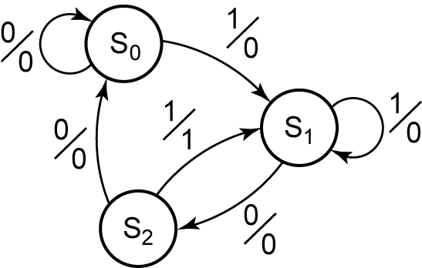

Example: A sequence detector (Mealy)
State Graph for the Mealy Machine

Slide 46
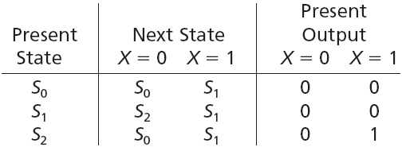

Example: A sequence detector (Mealy)
We can then convert our state graph to a state table:
Since there are 3 states, we only need 2 flip-flops for the circuit.

Slide 47
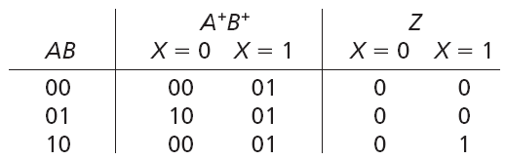
Example: A sequence detector (Mealy)
And then convert our state table to a transition table:

Slide 48
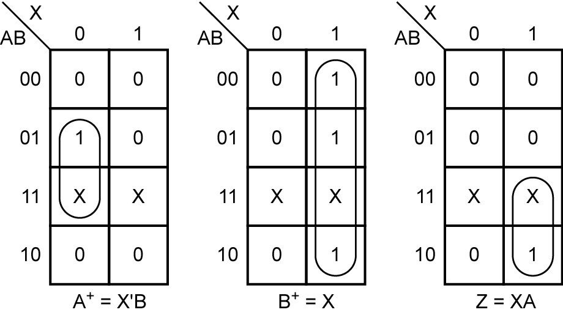
Example: A sequence detector (Mealy)
From the transition table, we can plot the next-state maps for the flip-flops and the map for the output function Z:

Slide 49
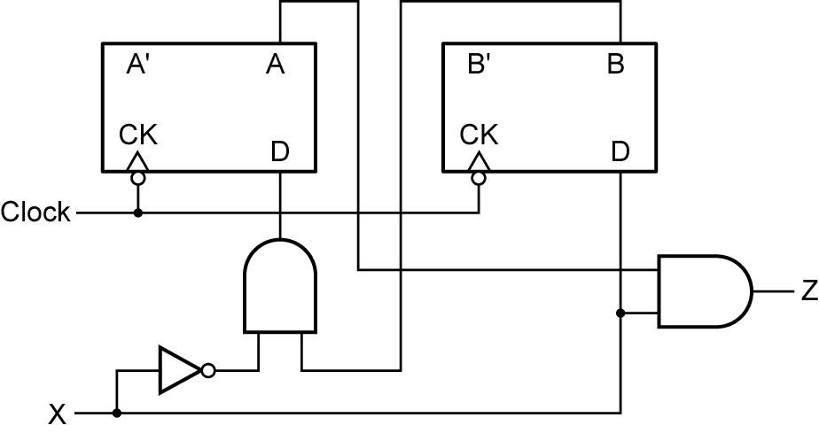
Example: A sequence detector (Mealy)
Using the derived equations, we can then draw the corresponding circuit diagram:

Slide 50
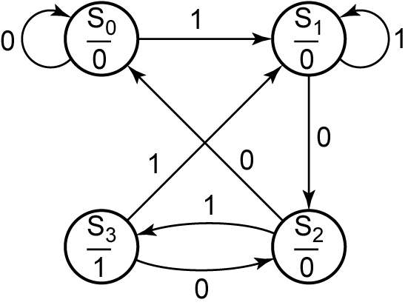

Example: A sequence detector (Moore)
State Graph for the Moore Machine

Slide 51
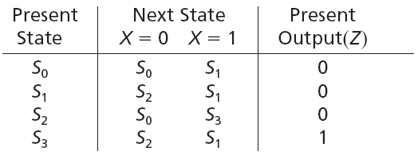
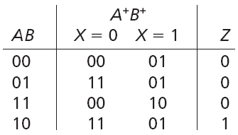

Example: A sequence detector (Moore)
As with the Mealy machine, the state and transition tables can be derived from the state graph:

Slide 52
Revision

Slide 53


Slide 54
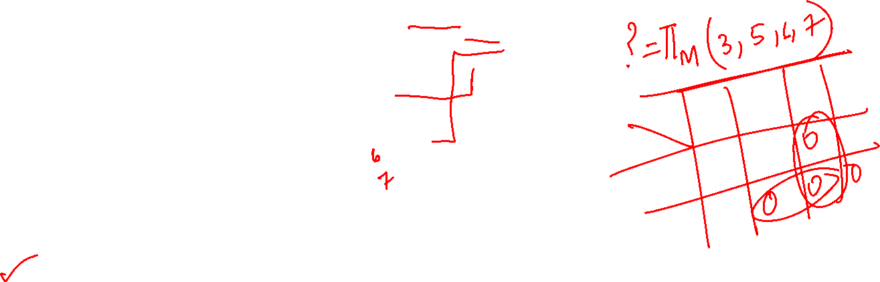

Slide 55

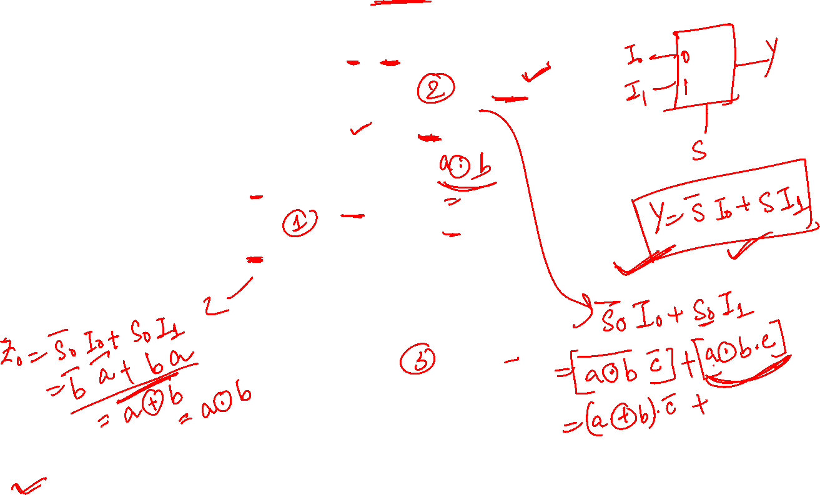

Slide 56
Counter Design

Slide 57
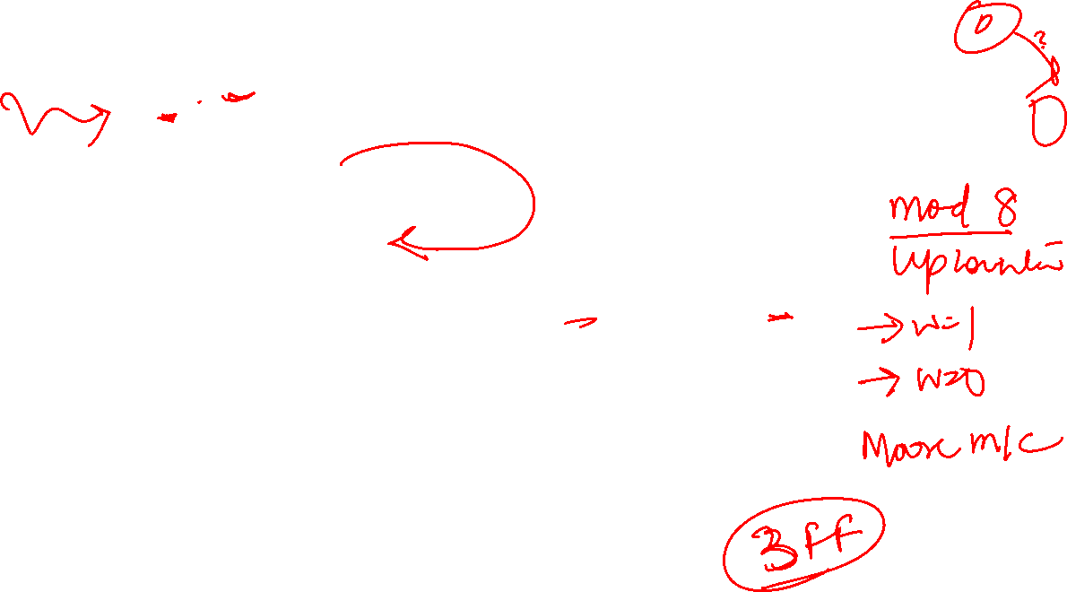
w
=
0
w
=
0
w
=
0
w
=
0
w
=
1
w
=
1
w
=
1
A/0
B/1
C/2
D/3
w
=
1
w
=
1
H/7
G/6
F/5
E/4
w
=
1
w
=
1
w
=
1
w
=
0
w
=
0
w
=
0
w
=
0
Figure 8.60. State diagram for the counter.

Slide 58
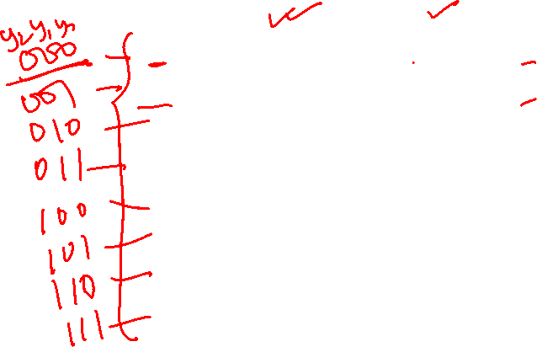
Present
Next state
Output
state
w
=
0
w
=
1
A
A
B
0
B
B
C
1
C
C
D
2
D
D
E
3
E
E
F
4
F
F
G
5
G
G
H
6
H
H
A
7
Figure 8.61. State table for the counter.

Slide 59

Next state
Present
Count
state
w
=
0
w
=
1
y
2
y
1
y
0
z
2
z
1
z
0
Y
2
Y
1
Y
0
Y
2
Y
1
Y
0
A
000
000
001
000
B
001
001
010
001
C
010
010
011
010
D
011
011
100
011
E
100
100
101
100
F
101
101
110
101
G
110
110
111
110
H
111
111
000
111
Figure 8.62. State-assigned table for the counter.

Slide 60
y
y
y
y
1
0
1
0
wy
2
wy
2
00
01
11
10
00
01
11
10
00
0
1
1
0
00
0
0
1
1
01
0
1
1
0
01
0
0
1
1
11
1
0
0
1
11
0
1
0
1
10
1
0
0
1
10
0
1
0
1
D
=
wy
+
wy
0
D
=
wy
+
y
y
+
wy
y
0
0
1
1
1
0
0
1
y
y
1
0
wy
2
00
01
11
10
00
0
0
0
0
01
1
1
1
1
11
1
1
0
1
10
0
0
1
0
D
=
wy
+
y
y
+
y
y
+
w
y
y
y
2
2
0
2
1
2
0
1
2
Figure 8.63. Karnaugh maps for D flip-flops for the counter.

Slide 61
w
Y
0
D
Q
y
0
Q
Y
1
D
Q
y
1
Q
Y
2
D
Q
y
2
Q
Clock
Resetn
Figure 8.64. Circuit diagram for the counter implemented
with D flip-flops.

Slide 62
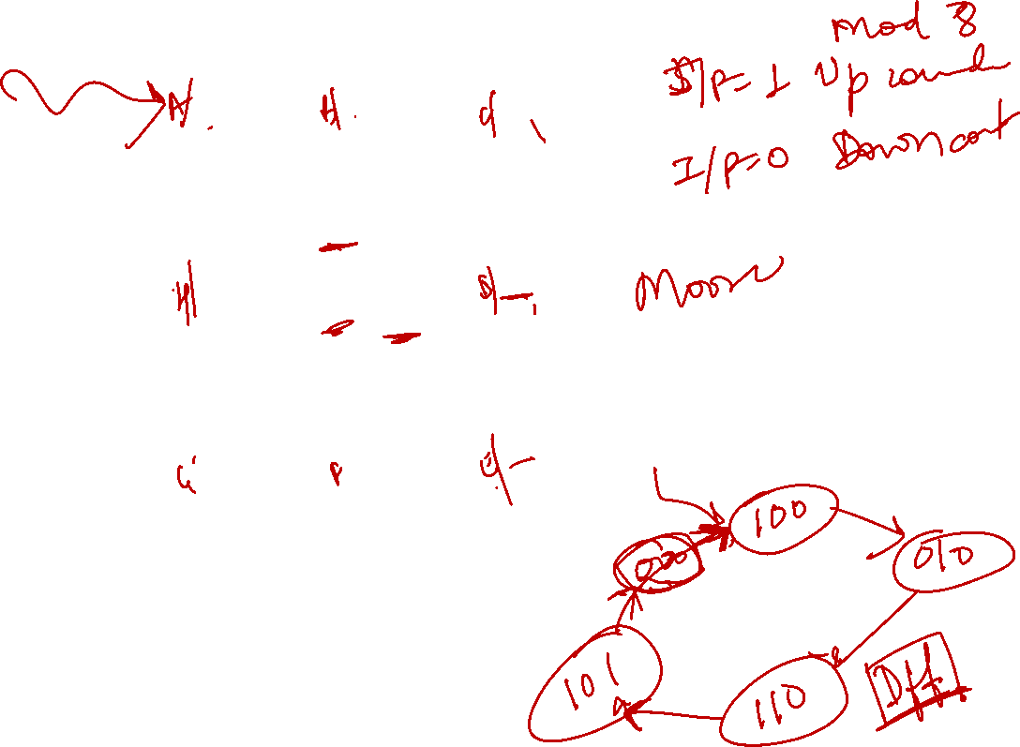

Slide 63
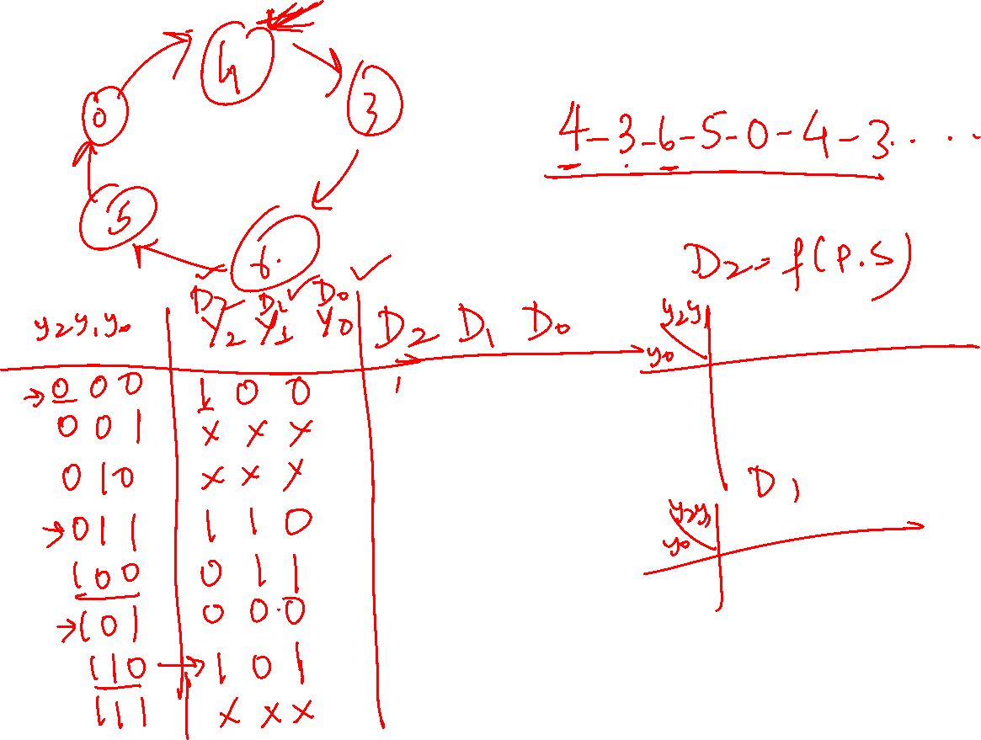


Slide 64
ALL THE BEST

